Slide 1
DBS Perceptual Results

Slide 2
Perceptual Ratings
Intelligibility (%)
Listening Effort (%)
Articulatory Precision (%)
Prosody (%)
Voice Quality (%)

Slide 3
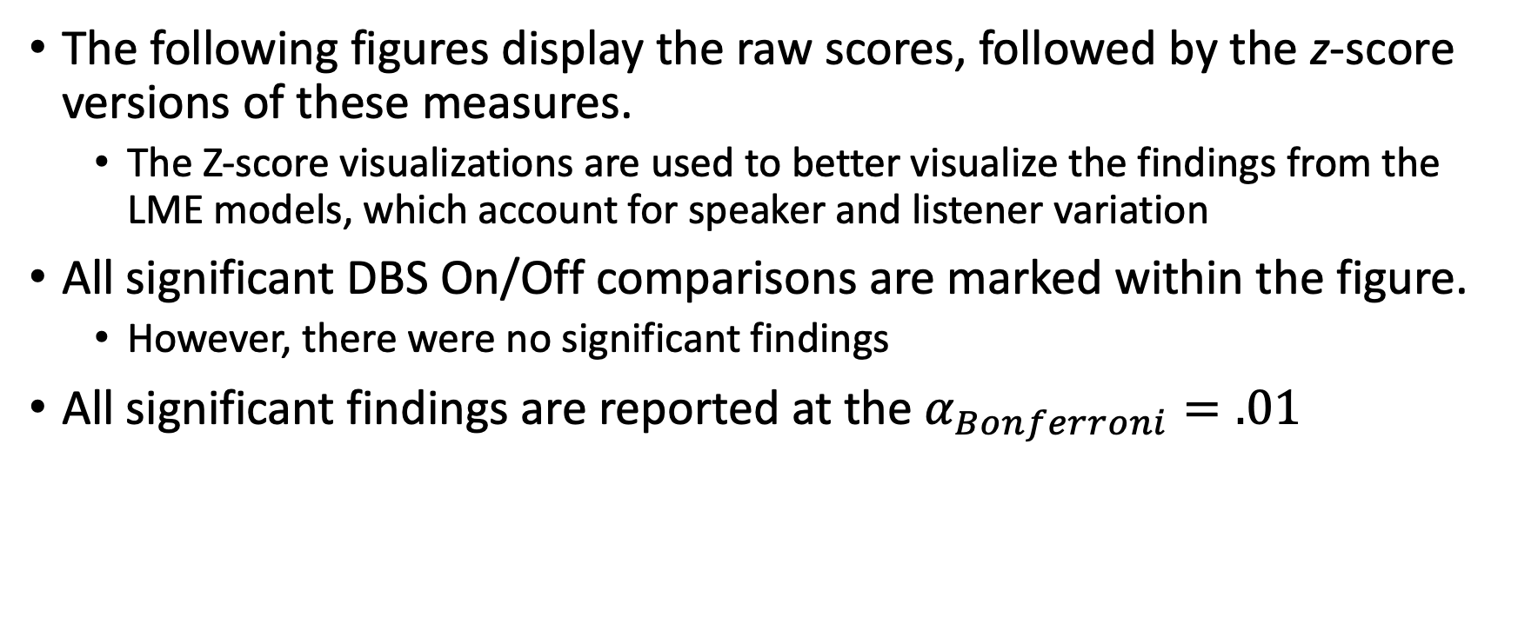
Notes
The following figures display the raw scores, followed by the z-score versions of these measures.
The Z-score visualizations are used to better visualize the findings from the LME models, which account for speaker and listener variation
All significant DBS On/Off comparisons are marked within the figure.
However, there were no significant findings
All significant findings are reported at the $α_{Bonferroni}=.01$

Slide 4
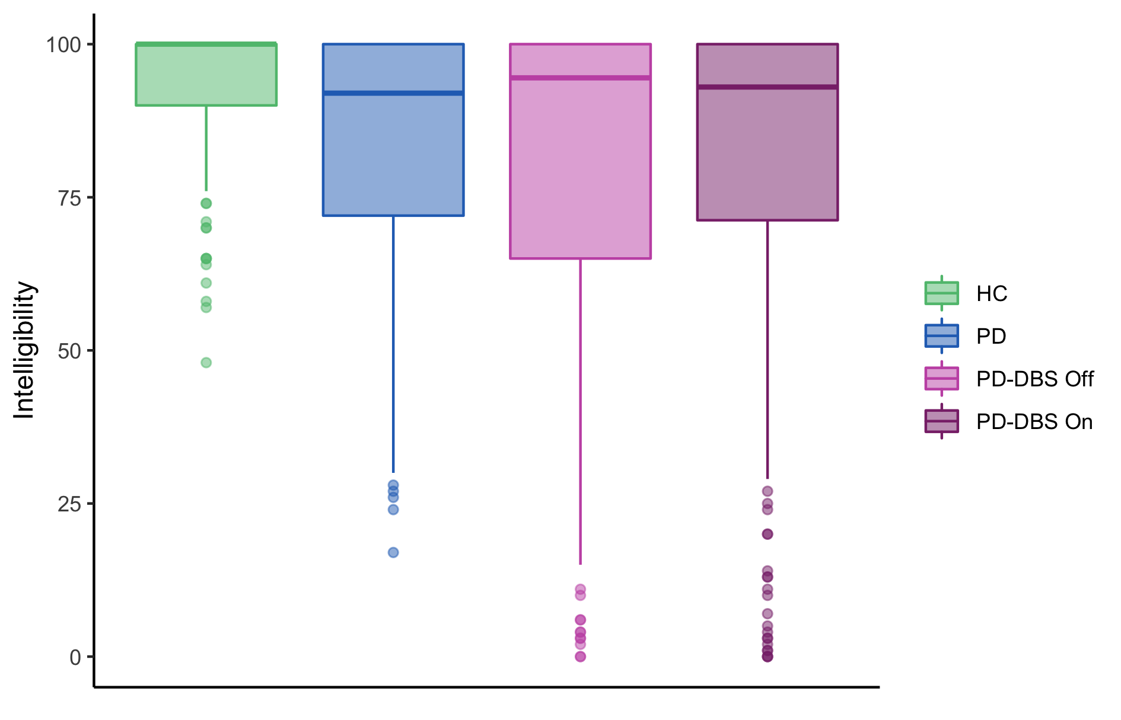
1. Intelligibility (%) - Raw
There was no significant DBS effect for the Intelligibility Ratings.

Slide 5
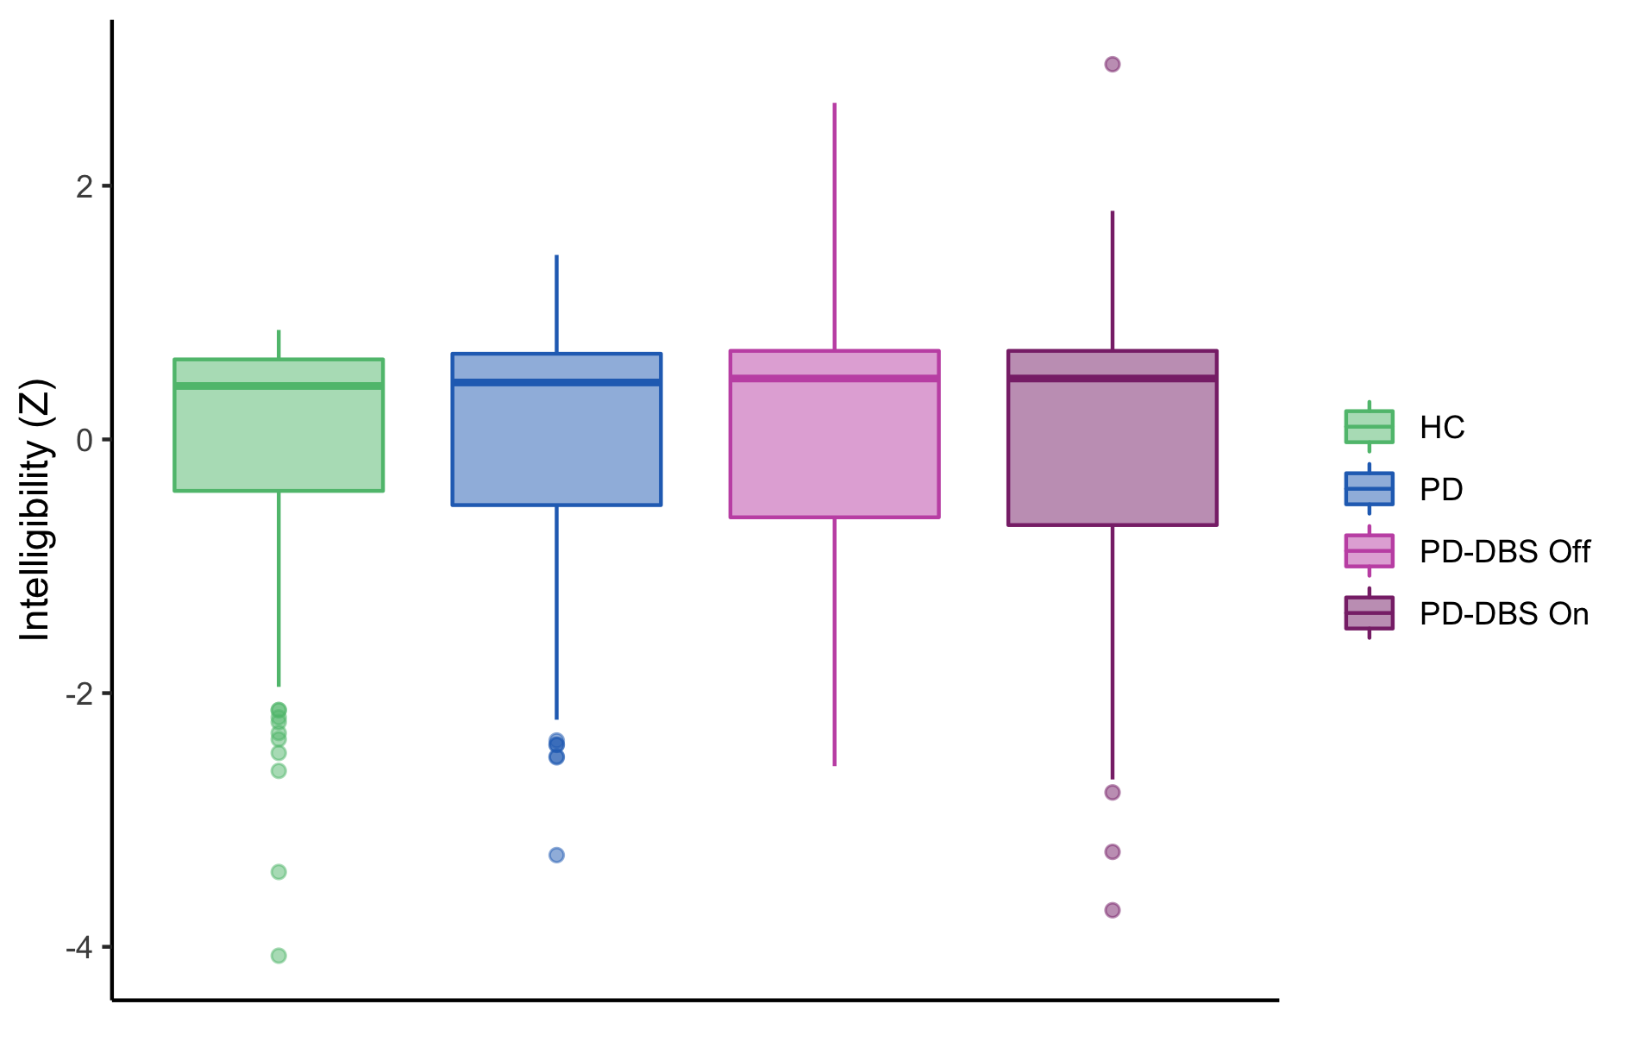
1. Intelligibility (%) - Z
There was no significant DBS effect for the Intelligibility Ratings.

Slide 6
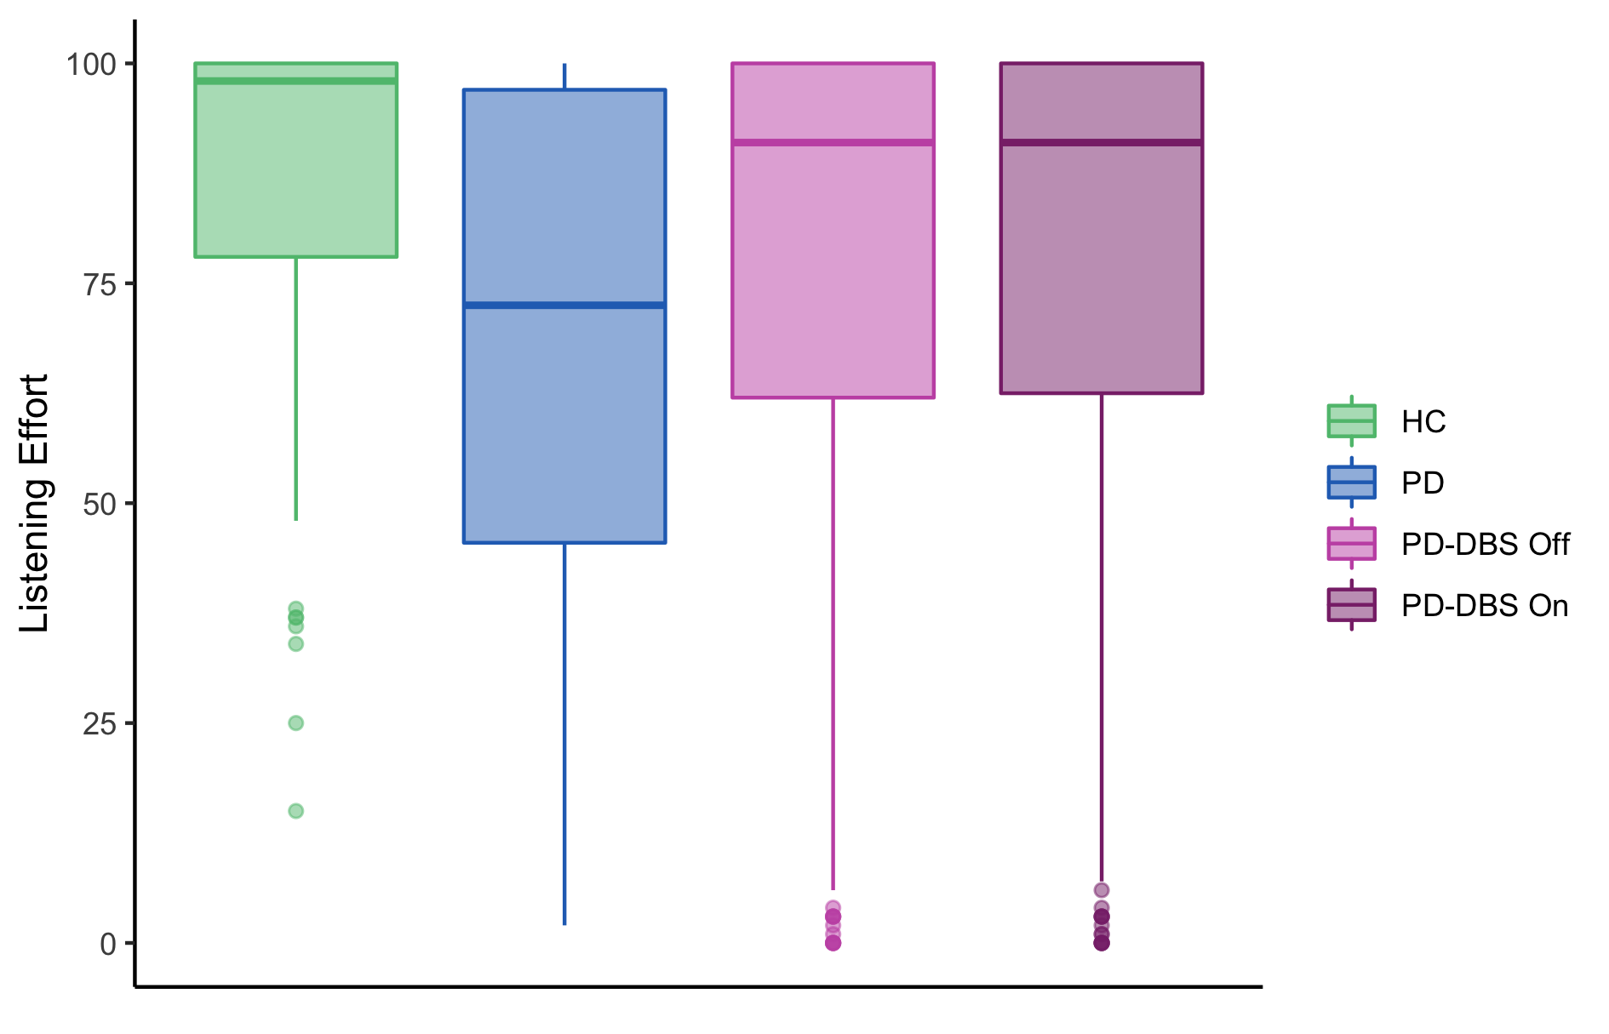
2. Listening Effort (%) - Raw
There was no significant DBS effect for the Listening Effort Ratings.

Slide 7
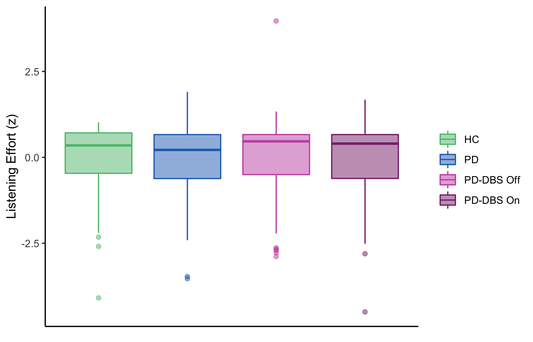
2. Listening Effort (%) - Z
There was no significant DBS effect for the Listening Effort Ratings.

Slide 8
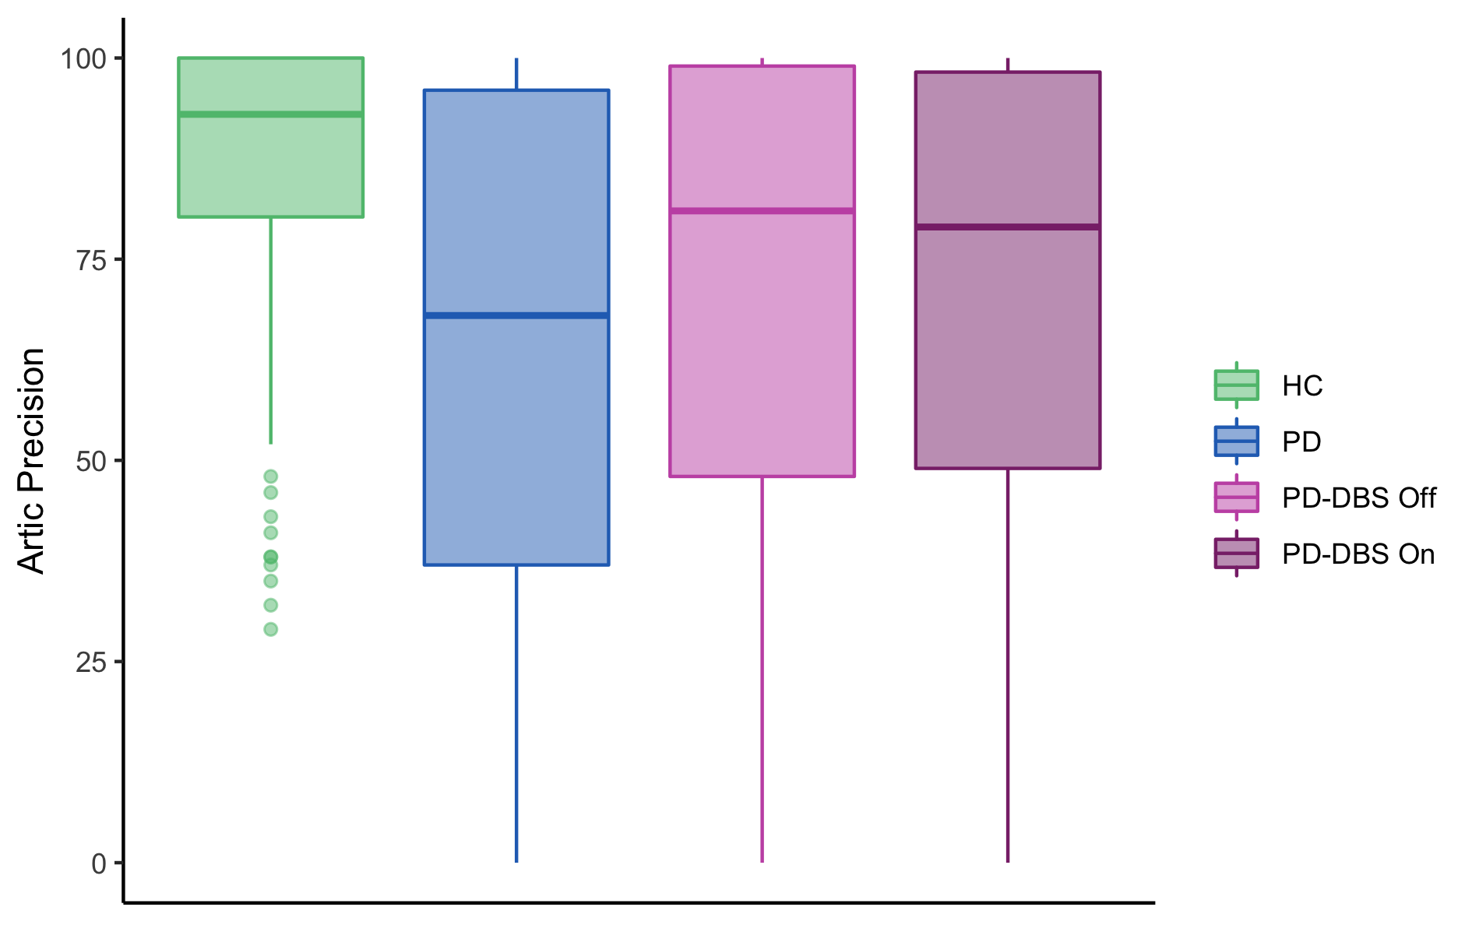
3. Articulatory Precision (%) - Raw
There was no significant DBS effect for the Articulatory Precision Ratings.

Slide 9
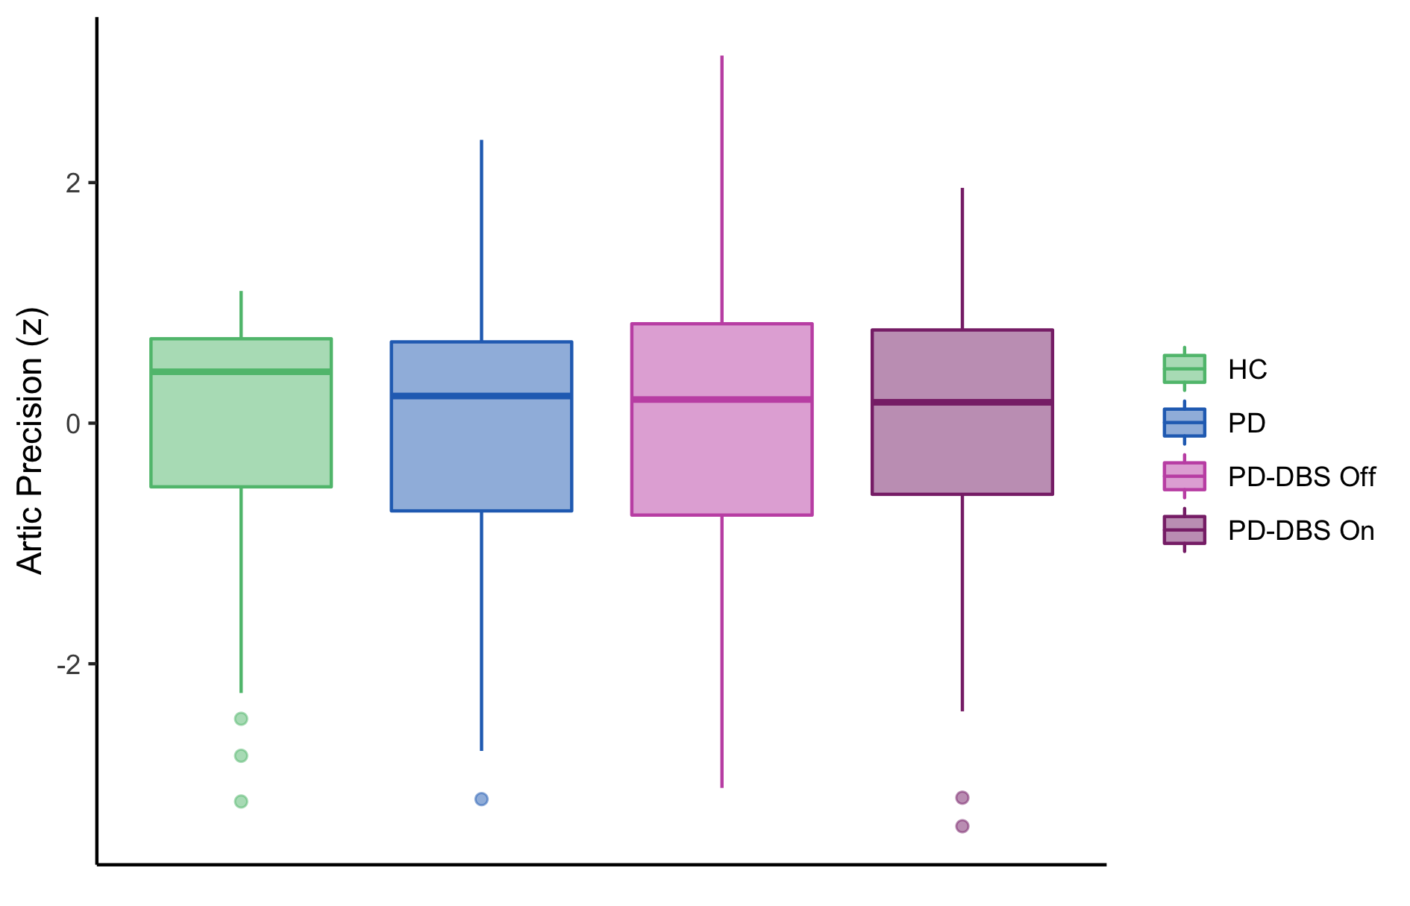
3. Articulatory Precision (%) - Z
There was no significant DBS effect for the Articulatory Precision Ratings.

Slide 10
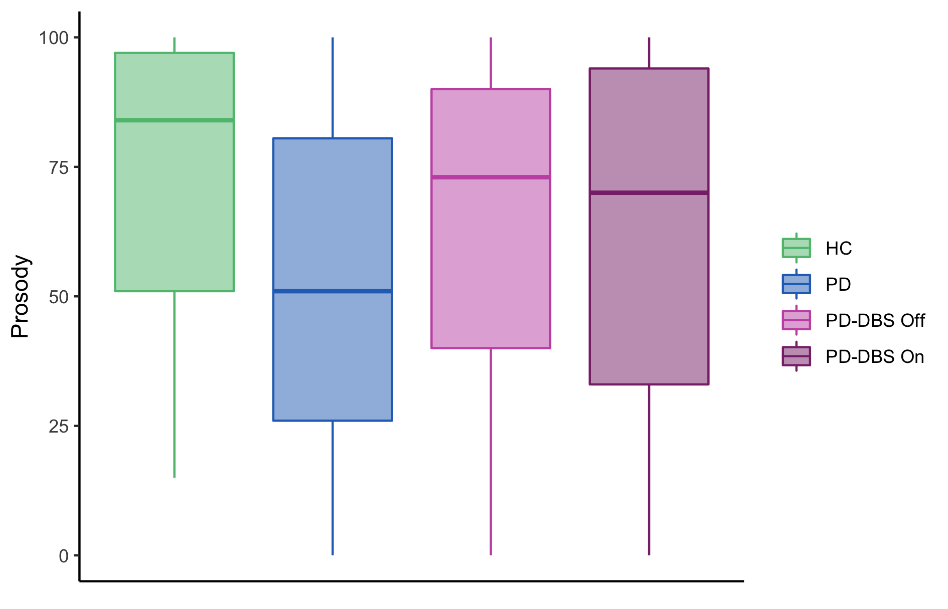
4. Prosody (%) - Raw
There was no significant DBS effect for the Prosody Ratings.

Slide 11
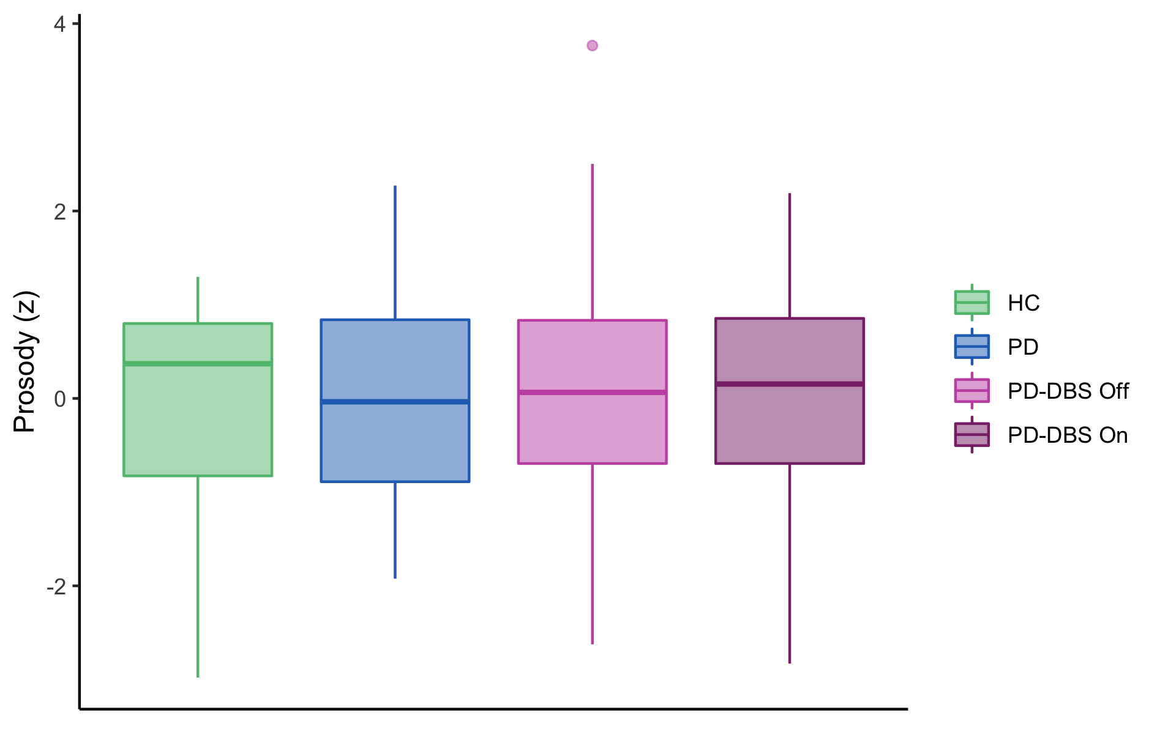
4. Prosody (%) - Z
There was no significant DBS effect for the Prosody Ratings.

Slide 12
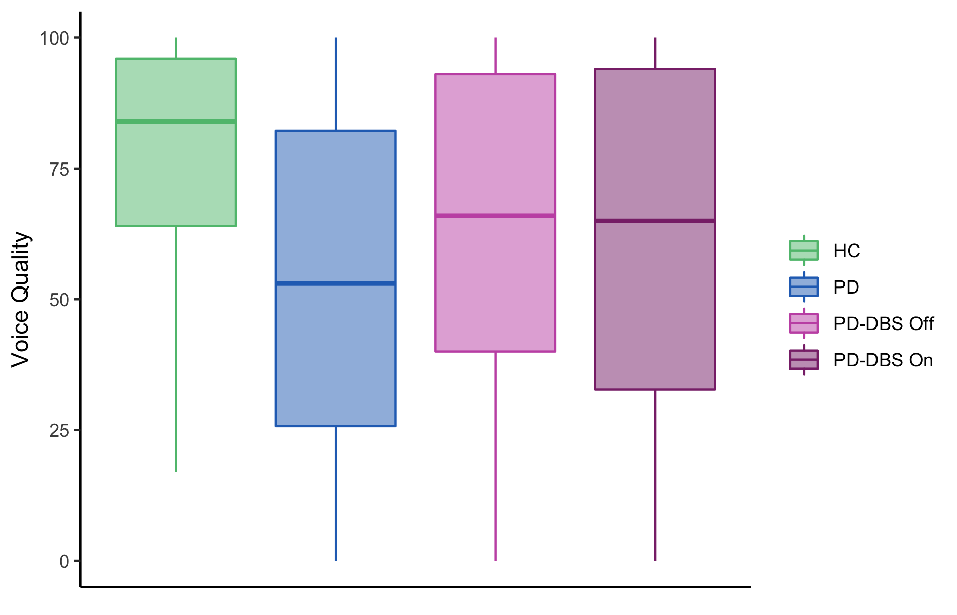
5. Voice Quality (%) - Raw
There was no significant DBS effect for the Prosody Ratings.

Slide 13
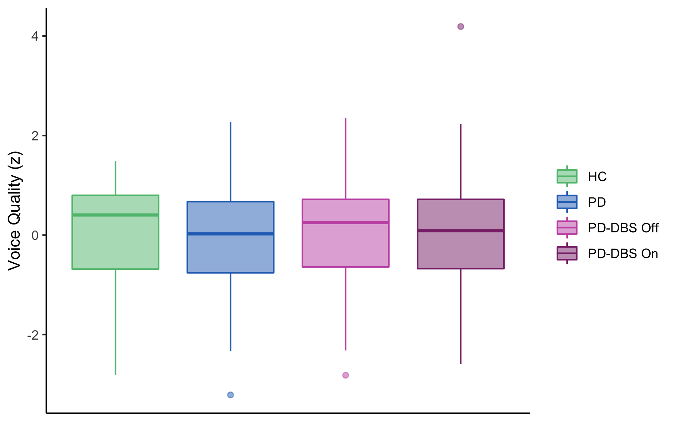
5. Voice Quality (%) - Z
There was no significant DBS effect for the Prosody Ratings.

Slide 14
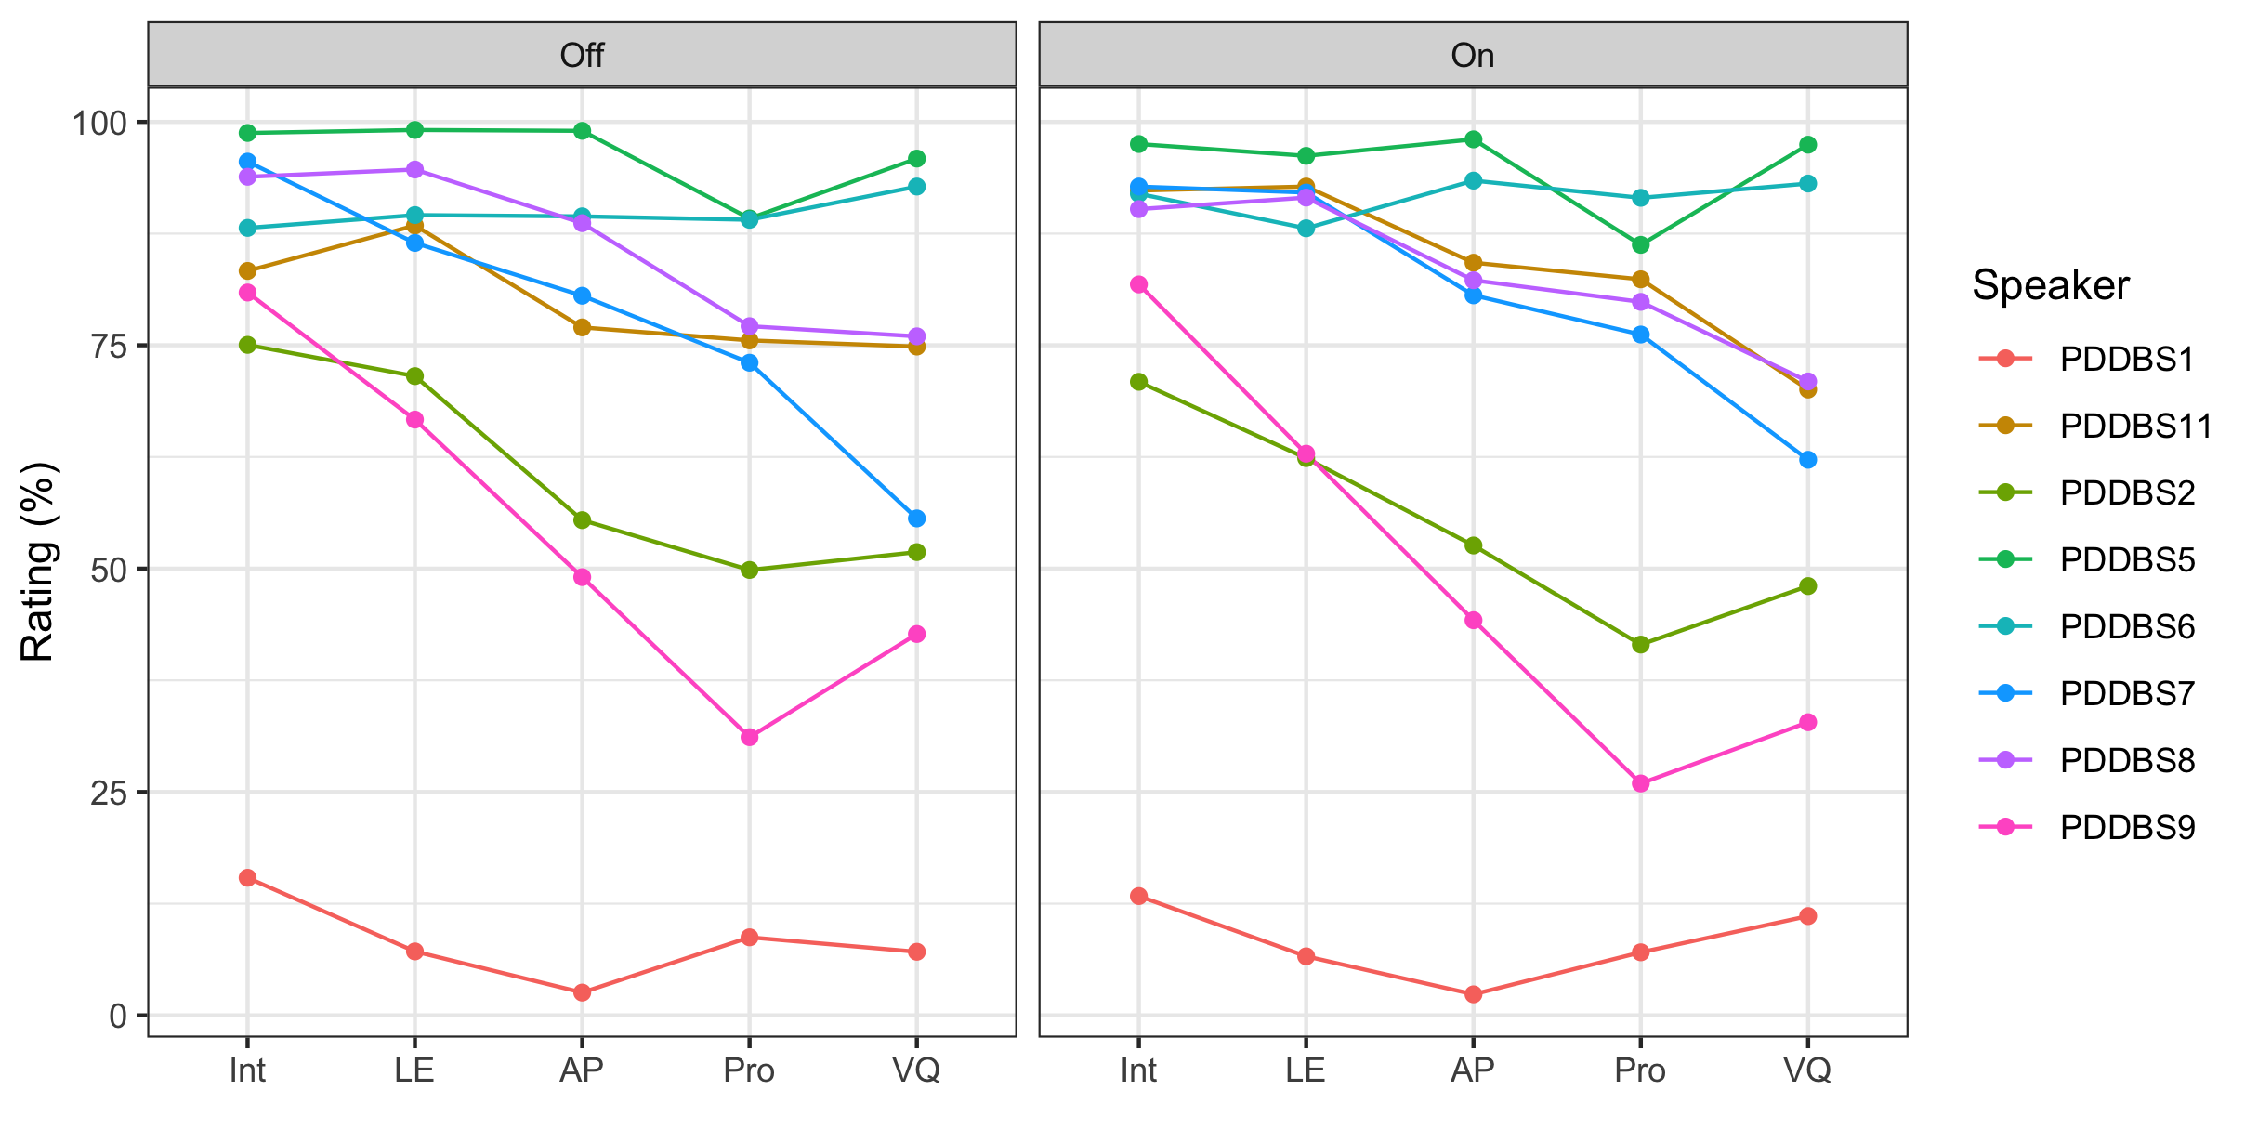
Individual Differences

Slide 15
Summary
No significant perceptual differences for DBS On/Off ☹

